Slide 1

The Environmental Consequences of Cryptocurrency Mining
Notes:
In today's digital age, where everything is becoming increasingly digitalized, including our money, it is crucial to acknowledge the environmental impact of cryptocurrency mining. In this presentation, I will share the findings of my research project, which aims to raise awareness and explore the environmental consequences of mining Bitcoin, Ethereum, and Dogecoin.

Slide 2
Problem Statement
The environmental impact of cryptocurrency mining, needs to be assessed in terms of energy consumption and carbon emissions.
Notes:
Problem Statement:
I believe The environmental impact of cryptocurrency mining, needs to be assessed in terms of energy consumption and carbon emissions in order to take actions accordingly and sustain our planet.

Slide 3
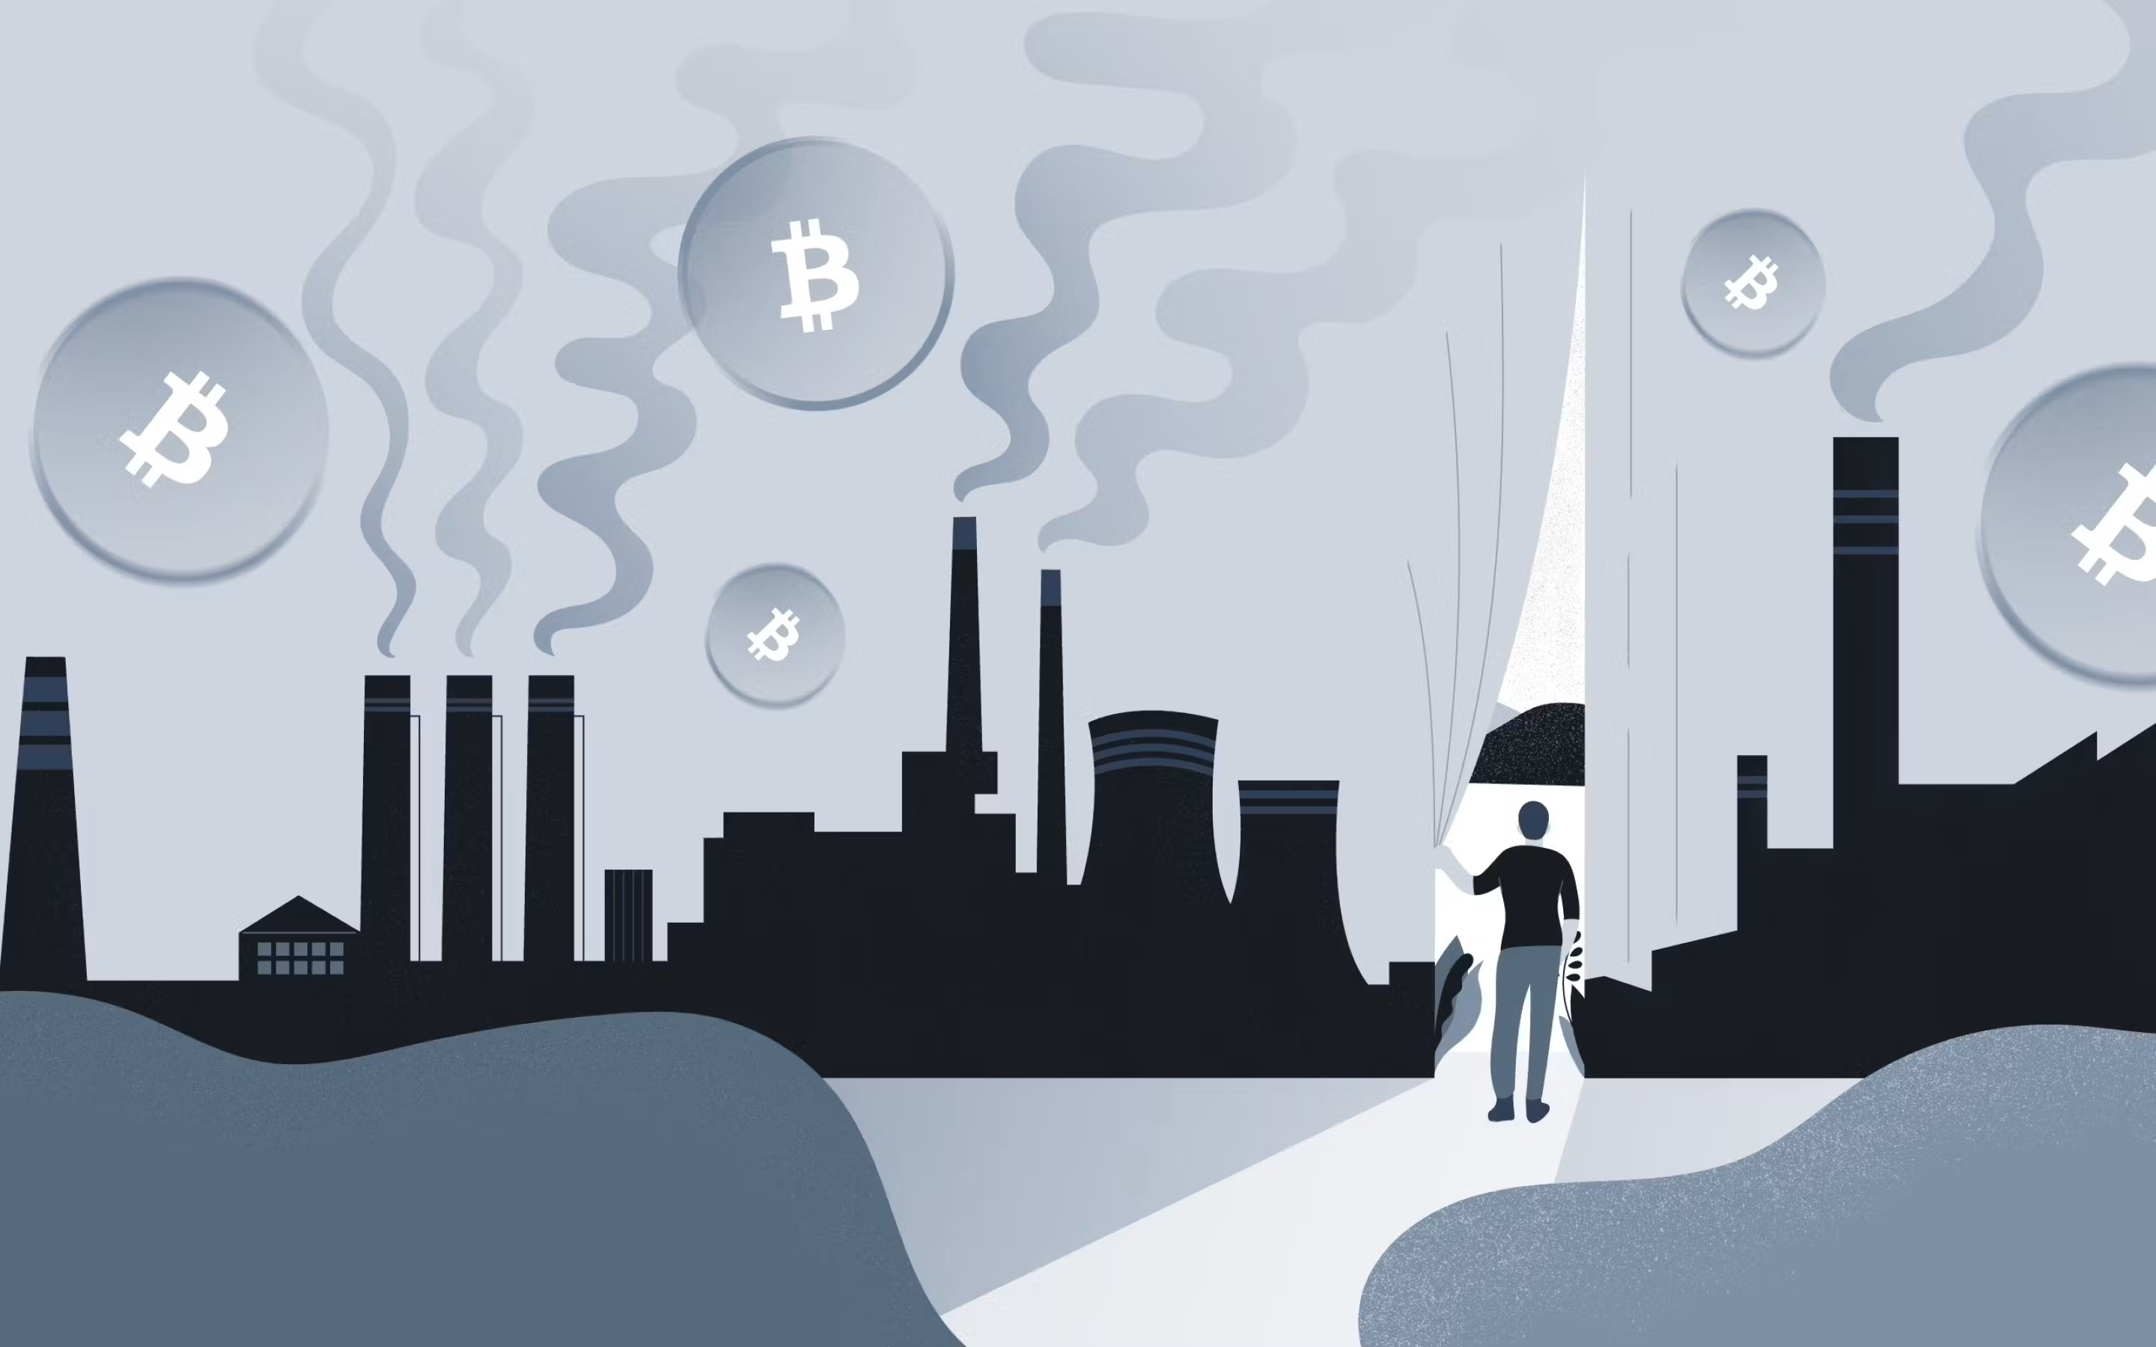


MAIN IDEA OF THE RESEARCH
Notes:
How will I do that? First, I wanted to know which of the three most well-known coins contribute the most to this effect so efforts can be directed towards it.

Slide 4

MAIN IDEA OF THE RESEARCH
Notes:
Secondly, I Explored the correlation between value of coin and the scale of its environmental degradation to see If I can predict how much the coin is affecting the environment based on its value at that time.

Slide 5

MAIN IDEA OF THE RESEARCH
Notes:
I also wanted to provide a comprehensive overview on the possibilities and challenges of the most promising solution I found during my literature review. I also wanted to dive beyond the theoretical feasibility to examine the communities opinions.

Slide 6
Research objective
Fully understand the effect of cryptocurrencies on the environment and explore the possibility of integrating the best-known solution to coins other than Ethereum.
Notes:
Understand the effect of cryptocurrencies on the environment through analyzing the power consumption and carbon emissions of three main cryptocurrencies and exploring the possible correlation between the coin’s value and the scale of this effect. Explore the possibility of integrating the best-known solution to coins other than Ethereum.

Slide 7
Research questions
Which of the three cryptocurrencies bitcoin, dogecoin and Ethereum has the most impact on the environment?
Is there any potential correlation between the value of cryptocurrencies and the scale of its environmental degradation?
What are the challenges and opportunities of employing PoS (proof of stake) consensus algorithms on Bitcoin?
Notes:
Understand the effect of cryptocurrencies on the environment through analyzing the power consumption and carbon emissions of three main cryptocurrencies and exploring the possible correlation between the coin’s value and the scale of this effect. Explore the possibility of integrating the best-known solution to coins other than Ethereum.

Slide 8

Data collection process
Notes:
Data collection process (challenges and merits).
Secondary data was collected from websites and research papers.
Issues: Inconsistencies, not knowing data collecting process, formatting of data was also not as I wanted. Too much time cleaning, understanding data and how they fill it.
The data igathered I couldn’t have collected it myself

Slide 9

Data collection process
Notes:
Reliable but time consuming

Slide 10

Data collection process
Notes:
Interviews (small sample size due to legal concerns but allowed me to dive deaper)

Slide 11

Data collection process
Notes:
Forums (took too much time but allowed me an insight into what the overall communities idea is in a non bias manner)

Slide 12

Data Analysis
Notes:
Data analysis

Slide 13
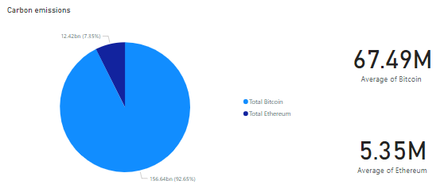
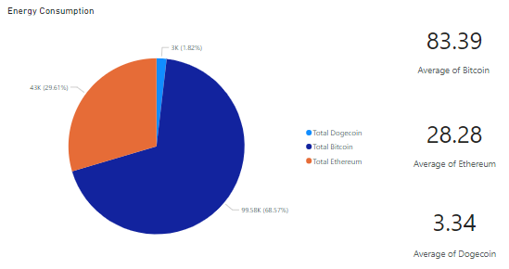
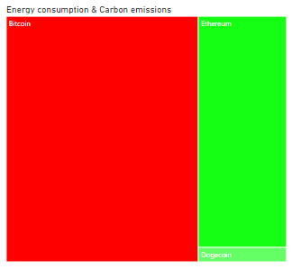
RESULTS AND RECOMMENDATIONS
Notes:
The analysis I did through Power BI showed that bitcoin has the most significant impact on the environment by far among the three cryptocurrencies, contributing to a higher amount of carbon emissions and energy consumption. Ethereum had a higher impact than Dogecoin but a lower impact than bitcoin and with the merge this impact significantly dropped.
Direct actions to bitcoin to decrease its impact (modify PoW to be less intensive, policies, incentives to using green energy when mining, increase awareness, etc.)

Slide 14
RESULTS AND RECOMMENDATIONS
Year | Correlation Coefficient | Value
2017 | 0.95 | Very high positive correlation
2018 | -0.19 | Low negative correlation
2019 | 0.96 | Very high positive correlation
2021 | 0.13 | Very low positive correlation
2022 | 0.78 | High positive correlation
AVERAGE | 0.526 | Moderate positive correlation
Year | Correlation Coefficient | Value
2017 | 0.74 | High positive correlation
2018 | 0.55 | Moderate positive correlation
2019 | 0.91 | Very high positive correlation
2021 | 0.88 | Very high positive correlation
2022 | 0.69 | High positive correlation
2023 | 0.53 | Moderate positive correlation
AVERAGE | 0.72 | High positive correlation
Year | Correlation Coefficient | Value
2021 | 0.19 | Very low positive correlation
2022 | 0.4 | Moderate positive correlation
2023 | 0.22 | Low positive correlation
AVERAGE | 0.27 | Low positive correlation
Notes:
For research question 2, I conducted a linear regression correlation analysis between the value of cryptocurrencies and the environmental degradation (more specifically the energy consumption). The results varied across different years, indicating a complex relationship influenced by factors such as media attention, public interest, market corrections, and regulatory changes. While there was some positive correlation between cryptocurrency value and environmental degradation, the relationship was not consistently significant. These results suggest that we can’t assume that the value of cryptocurrency is an indicator of how much the environment is affected since the value is affected by unexpected factors.
No predictive analysis could be performed, further research can explore what other factors contribute and if we can predict by incorporating these factors (multiple linear regression)

Slide 15
RESULTS AND RECOMMENDATIONS
Switching to PoS is theoretically feasible.
Future research to developing PoW algorithms that prioritize time as opposed to energy or implementing a hybrid approach that combines PoW and PoS.
Notes:
The findings imply that using Proof of Stake (PoS) consensus techniques on Bitcoin is theoretically feasible. However, there are certain challenges to overcome. The Bitcoin community is firmly dedicated to the Proof of Work (PoW) consensus, and many individuals believe that PoW is a secure and efficient method of transaction validation. Furthermore, there is concern about centralization, potential security risks, initial token distribution concerns, and the idea that PoS lacks appropriate incentives. As a result, while implementing PoS on Bitcoin is technically conceivable, it would necessitate addressing these problems as well as obtaining greater acceptance and support from the Bitcoin community. Lastly, alternative solutions are proposed: using PoW algorithms that prioritize time as opposed to consuming excessive amounts of energy or implementing a hybrid approach that combines PoW and PoS.

Slide 16
Improvements AND future work
Employ primary data through surveys when possible
Adapt to change faster
Narrow down the scope of the research
Explore a method to predict the energy consumption of the coin.
Notes:
Based on the lessons learnt, below are suggested future improvements, and research consideration and then show how you recommend these actions based on your personal reflection.
1. I faced issues with inconsistent data collection and formatting from websites, so I will develop a more systematic approach in the future. This entails developing criteria for picking trustworthy sources as well as ensuring complete data cleaning and preparation. In addition, I will look at other data collection methods, such as primary data collection if possible or direct collaboration with data suppliers, to see whether these may help enhance data quality and control.
2. In forums and interviews, I also encountered the limitation of sample representativeness. In the future, I will utilize stratified sampling techniques to ensure that the sample appropriately represents the target population. In addition, I plan to reach out to a larger audience via online platforms or professional networks.
3. As suggested before, surveys can be a valuable alternative research method to gain insight into the communities' perspective. Surveys allow for anonymity, reducing bias and encouraging participants to provide honest responses.
4. In the future, I will retain a reflective mentality throughout the research process and be open to adjusting research methodologies in response to new problems or unexpected occurrences. Revisiting the study aims and objectives on a regular basis, reviewing the efficiency of the chosen procedures, and making appropriate revisions can help mitigate negative repercussions and keep the research on track.

Slide 17
Thanks !
Notes:
Based on the lessons learnt, below are suggested future improvements, and research consideration and then show how you recommend these actions based on your personal reflection.
1. I faced issues with inconsistent data collection and formatting from websites, so I will develop a more systematic approach in the future. This entails developing criteria for picking trustworthy sources as well as ensuring complete data cleaning and preparation. In addition, I will look at other data collection methods, such as primary data collection if possible or direct collaboration with data suppliers, to see whether these may help enhance data quality and control.
2. In forums and interviews, I also encountered the limitation of sample representativeness. In the future, I will utilize stratified sampling techniques to ensure that the sample appropriately represents the target population. In addition, I plan to reach out to a larger audience via online platforms or professional networks.
3. As suggested before, surveys can be a valuable alternative research method to gain insight into the communities' perspective. Surveys allow for anonymity, reducing bias and encouraging participants to provide honest responses.
4. In the future, I will retain a reflective mentality throughout the research process and be open to adjusting research methodologies in response to new problems or unexpected occurrences. Revisiting the study aims and objectives on a regular basis, reviewing the efficiency of the chosen procedures, and making appropriate revisions can help mitigate negative repercussions and keep the research on track.

